Slide 1
Large scale 3d printing with CDPR
Cadence Boronkay

Slide 2
Research, planning, scope

Slide 3
Design goals + constraints
Scalable
Modular for in situ applications
Precision satisfactory for 3d printing
Visually/aesthetically appealing

Slide 4
Previous work
CDPR robots have been used at large scales (eg. construction), but typically for pick and place purposes, rather than additive manufacturing.
Some 3d CDPR printers have been built at smaller scales, and with less modularity (fully constrained, many cables, fixed winch locations).
There is a literature available on fully constrained CDPR printers but much less on underactuated (cable suspended) CDPRs.

Slide 5
CDPR constraining
m = number of cables, n = degrees of freedom
m < n + 1 : under-constrained/underactuated (cable suspended)
m = n + 1 : fully constrained
m > n + 1 : redundantly constrained
For 6 DOFs (full control of position and orientation), 8 cables are typically used.
This is more complex, as one must avoid cable-cable and cable-end effector interference.

Slide 6
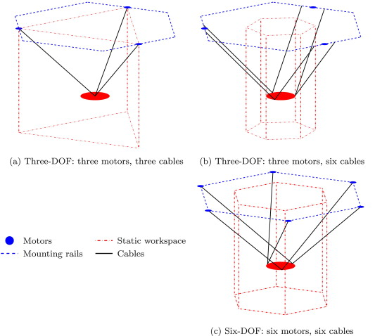
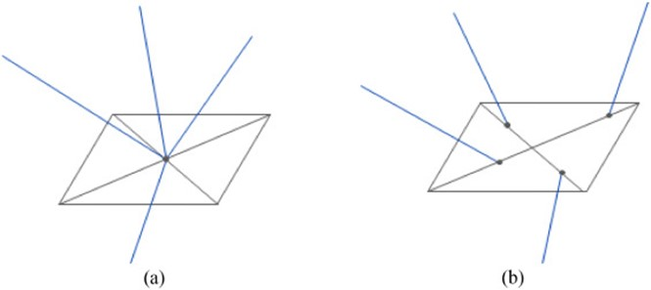
CDPR constraining (cable arrangements)
Ben Hamida, Ines, et al. “Multi-Objective Optimal Design of a Cable Driven Parallel Robot for Rehabilitation Tasks.”
Mechanism and Machine Theory, vol. 156, 2021, p. 104141, https://doi.org/10.1016/j.mechmachtheory.2020.104141.
4 cables with unaligned attachment points allow
for 3 DOF plus additional rotational mobility.
Barnett, Eric, and Clément Gosselin. “Large-Scale 3D Printing with a Cable-Suspended Robot.”
Additive Manufacturing, vol. 7, 2015, pp. 27–44, https://doi.org/10.1016/j.addma.2015.05.001.
Choice of # cables will effect workspace size.

Slide 7
Controls
Encoder options
Encoder on motor/winch (will have error due to irregular winch diameter from cable spooling)
*Rotary encoder on pulley (requires no cable slip on pulley, nonaxial forces due to the pulley on the encoder shaft could be problematic)
Draw wire/cable pull encoder (limits scale-up, maximum draw length of encoder determines possible cable travel).
Still researching software options for trajectory control/path generation from G-code.
WireX, Hangprinter…

Slide 8
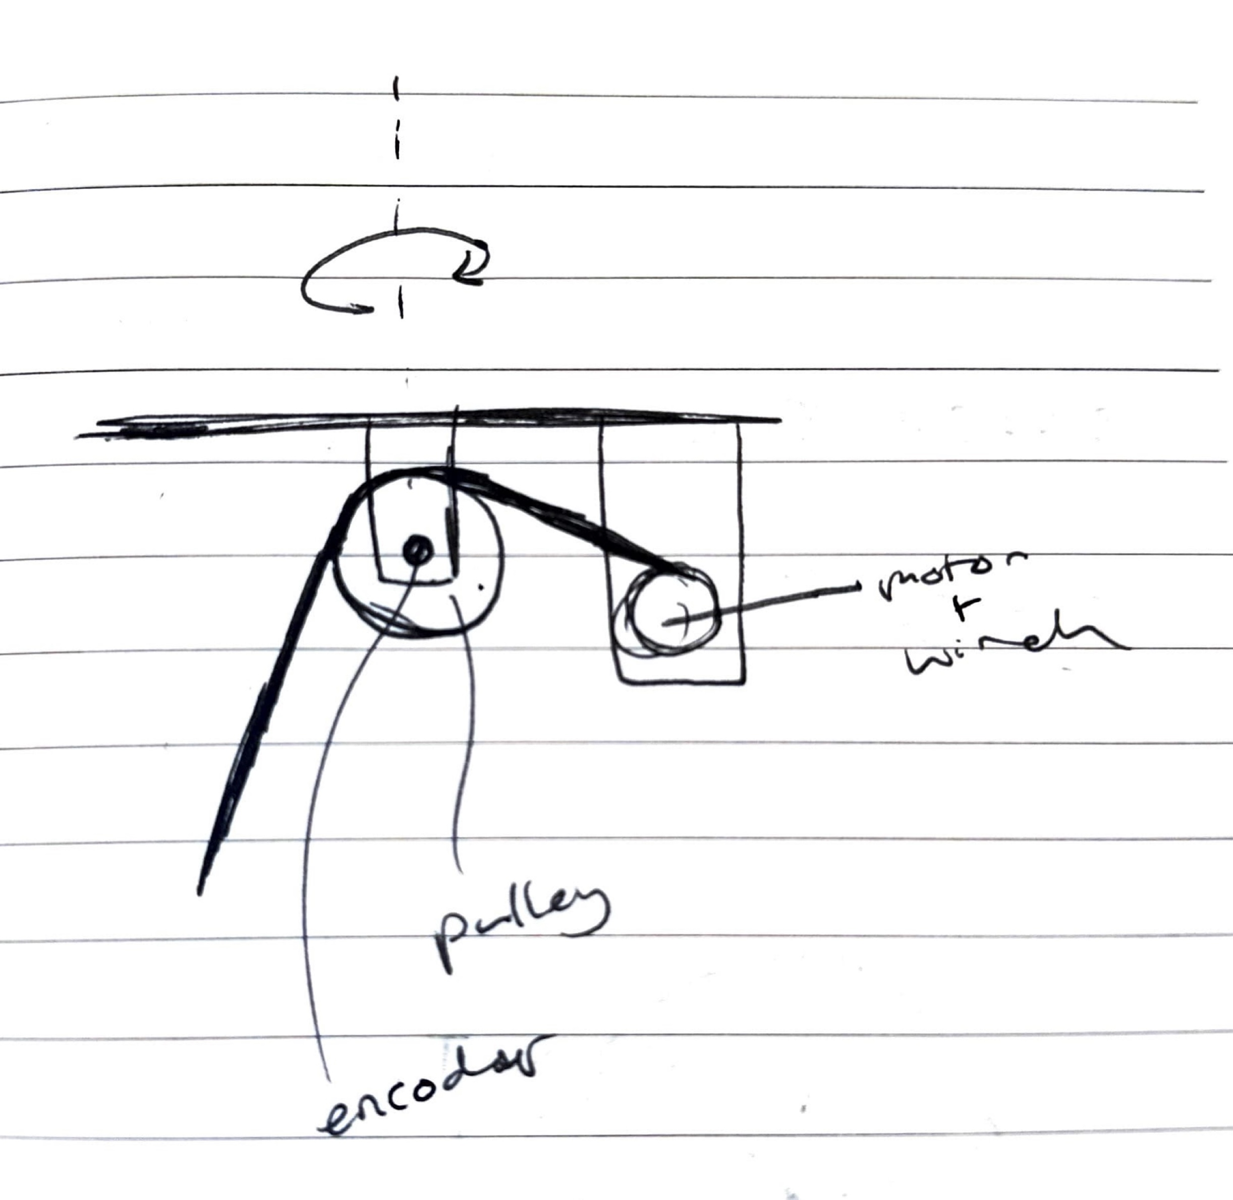
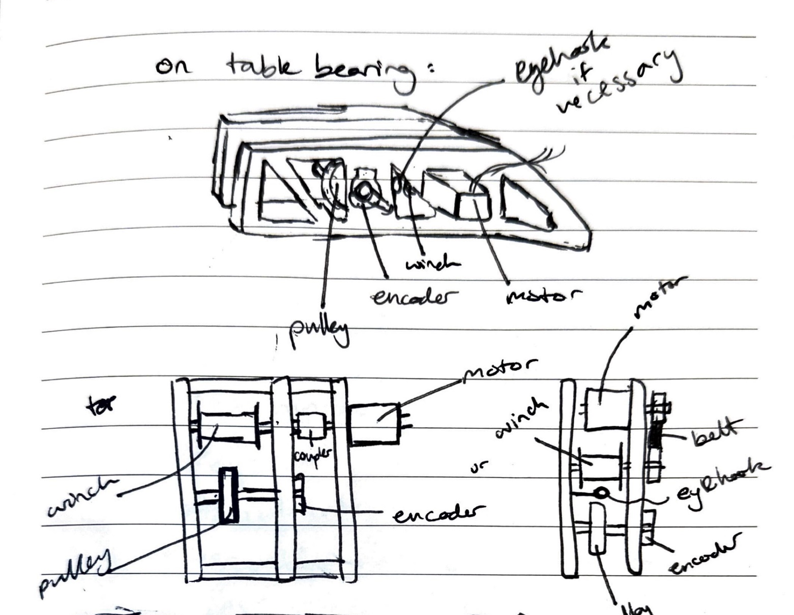
Initial design sketching

Slide 9
Design Considerations
Pulley
U-groove
Eyehook to guide cable (prevent derailing)
For encoder, cable must not slip on pulley (pulley needs to rotate with cable the entire time)
Rubber coating? High traction material?
If slippage is unavoidable, encoder could be moved to separate measuring wheel. (still need to somehow prevent slippage -> maybe dual-side wheels?)
Check mechanical + dynamic calculations: need weight of end-effector, pulley material for friction coefficient, motor torque, etc.

Slide 10
Design Considerations
Turntable
Probably best to put pulley on a table bearing - more accurate cable length measurements and less non-axial loads on cable and pulley. (Expected to be more significant on large-scale).
Put entire module on turntable or just pulley?
I think more entire is more modular and elegant, but possibly unnecessary).
Table bearing axis of rotation needs to be centered above last point of contact (pulley) for controls. (Parametric measurements done from here too).

Slide 11
Planning
Small-scale prototype design, continue controls research
Fabricate prototype, assembly 1 module (module = 1 set of motor/winch/pulley)
Test module
Revision
Fabricate + assemble m modules
Assemble m cable system
Test system (small scale CDPR)
Revise
Work on scale-up of module

Slide 12
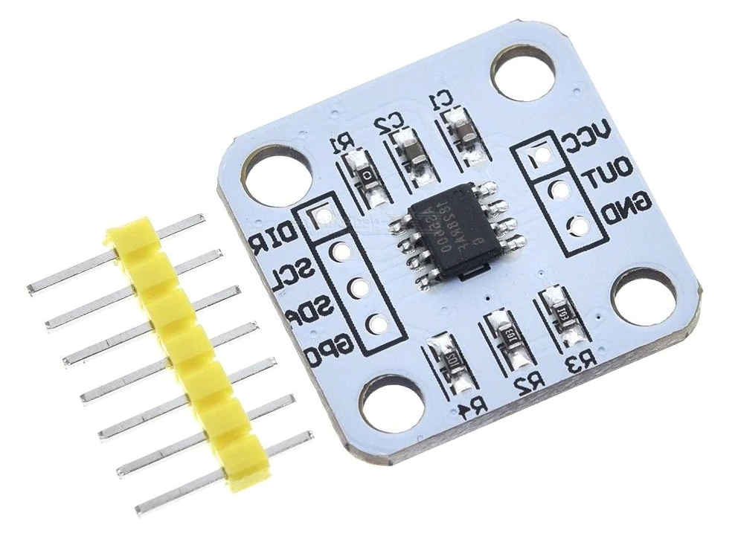
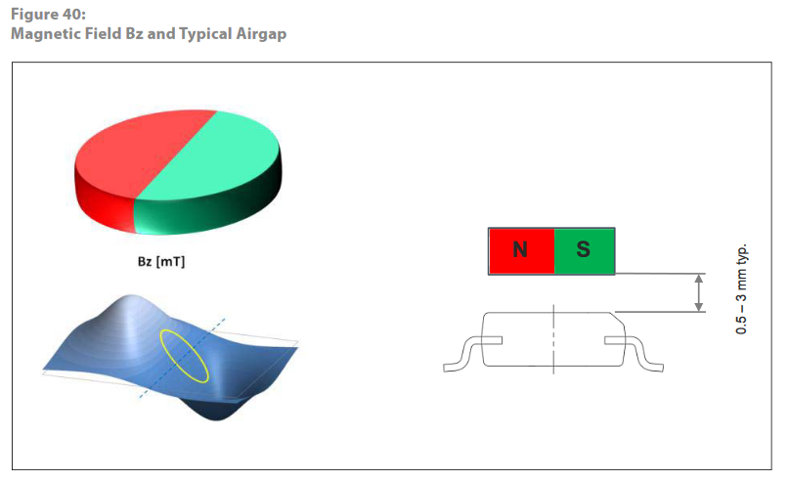
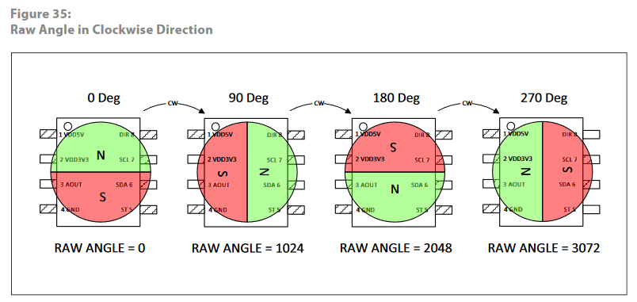
Magnetic position encoder
Hall sensor AS5600 magnetic position encoder
Non-contact, high precision (4096 positions = 0.087 degrees res)
Max allowable displacement of rotational axis is
0.25 mm
ams Datasheet
Useful: https://curiousscientist.tech/blog/as5600-magnetic-position-encoder

Slide 13
Mechanical Design
Small-scale version of CDPR mechanism

Slide 14
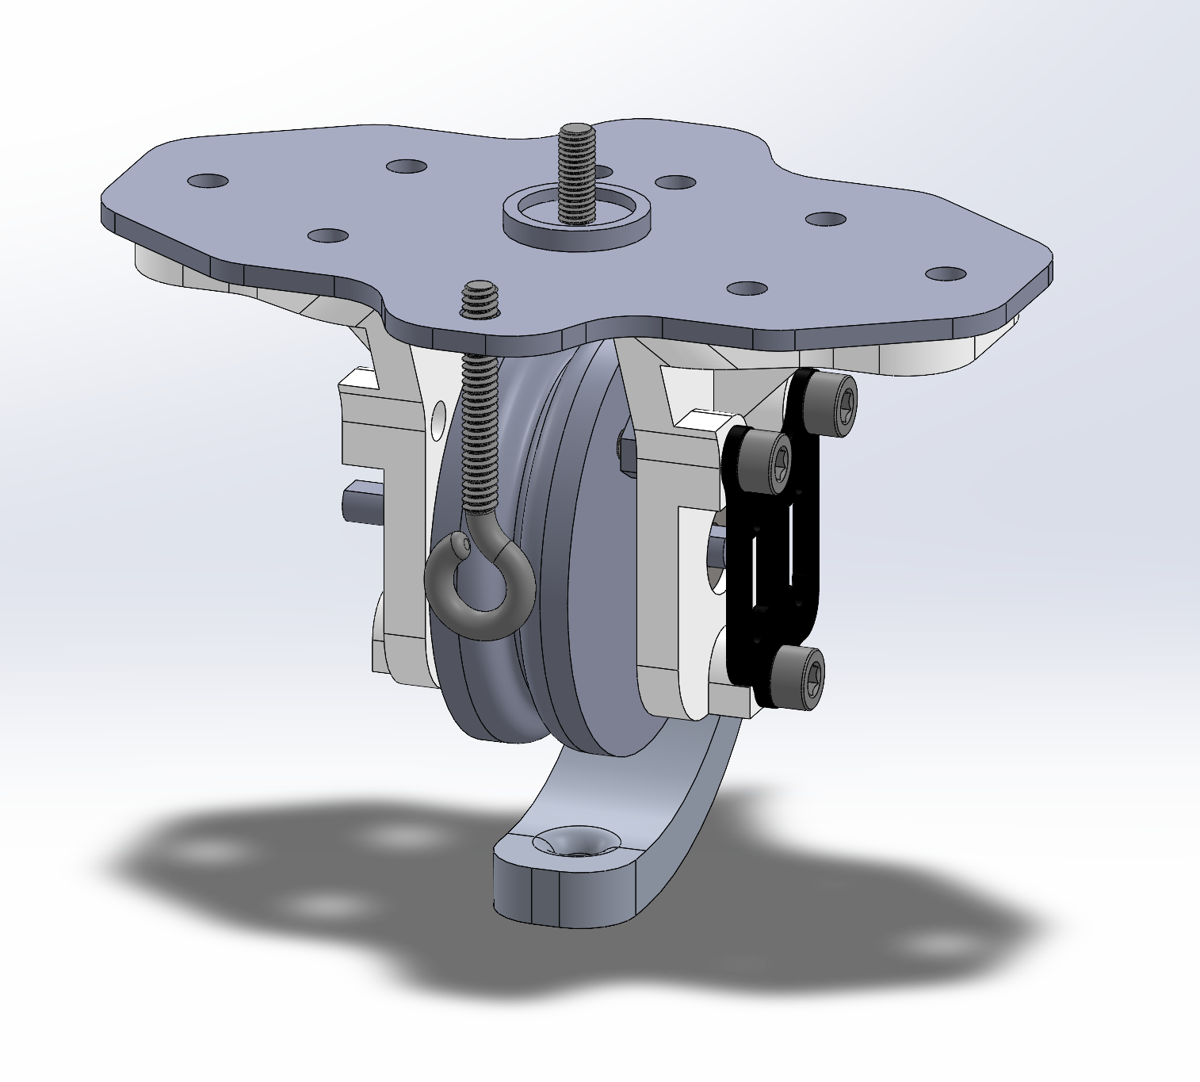
Pulley module
Rotational axis
Pulley for rope (currently thin string) needs to have enough friction to prevent slippage between string and pulley, as slippage would cause tracking error with the encoder.
Need string exit point to be fixed. Since these pulleys rotate, the exit point is directly below the rotational axis such that rotation does not effect where the string ends contact with the module. (However, with both the rope guide and the eyebolt, it seems unnecessary to have the ability to rotate).
Magnet for encoder is glued to the end of the shaft. Must be concentric and within 1-3mm of the encoder itself.
Encoder mount
(encoder is attached to inner face)
String exit point

Slide 15
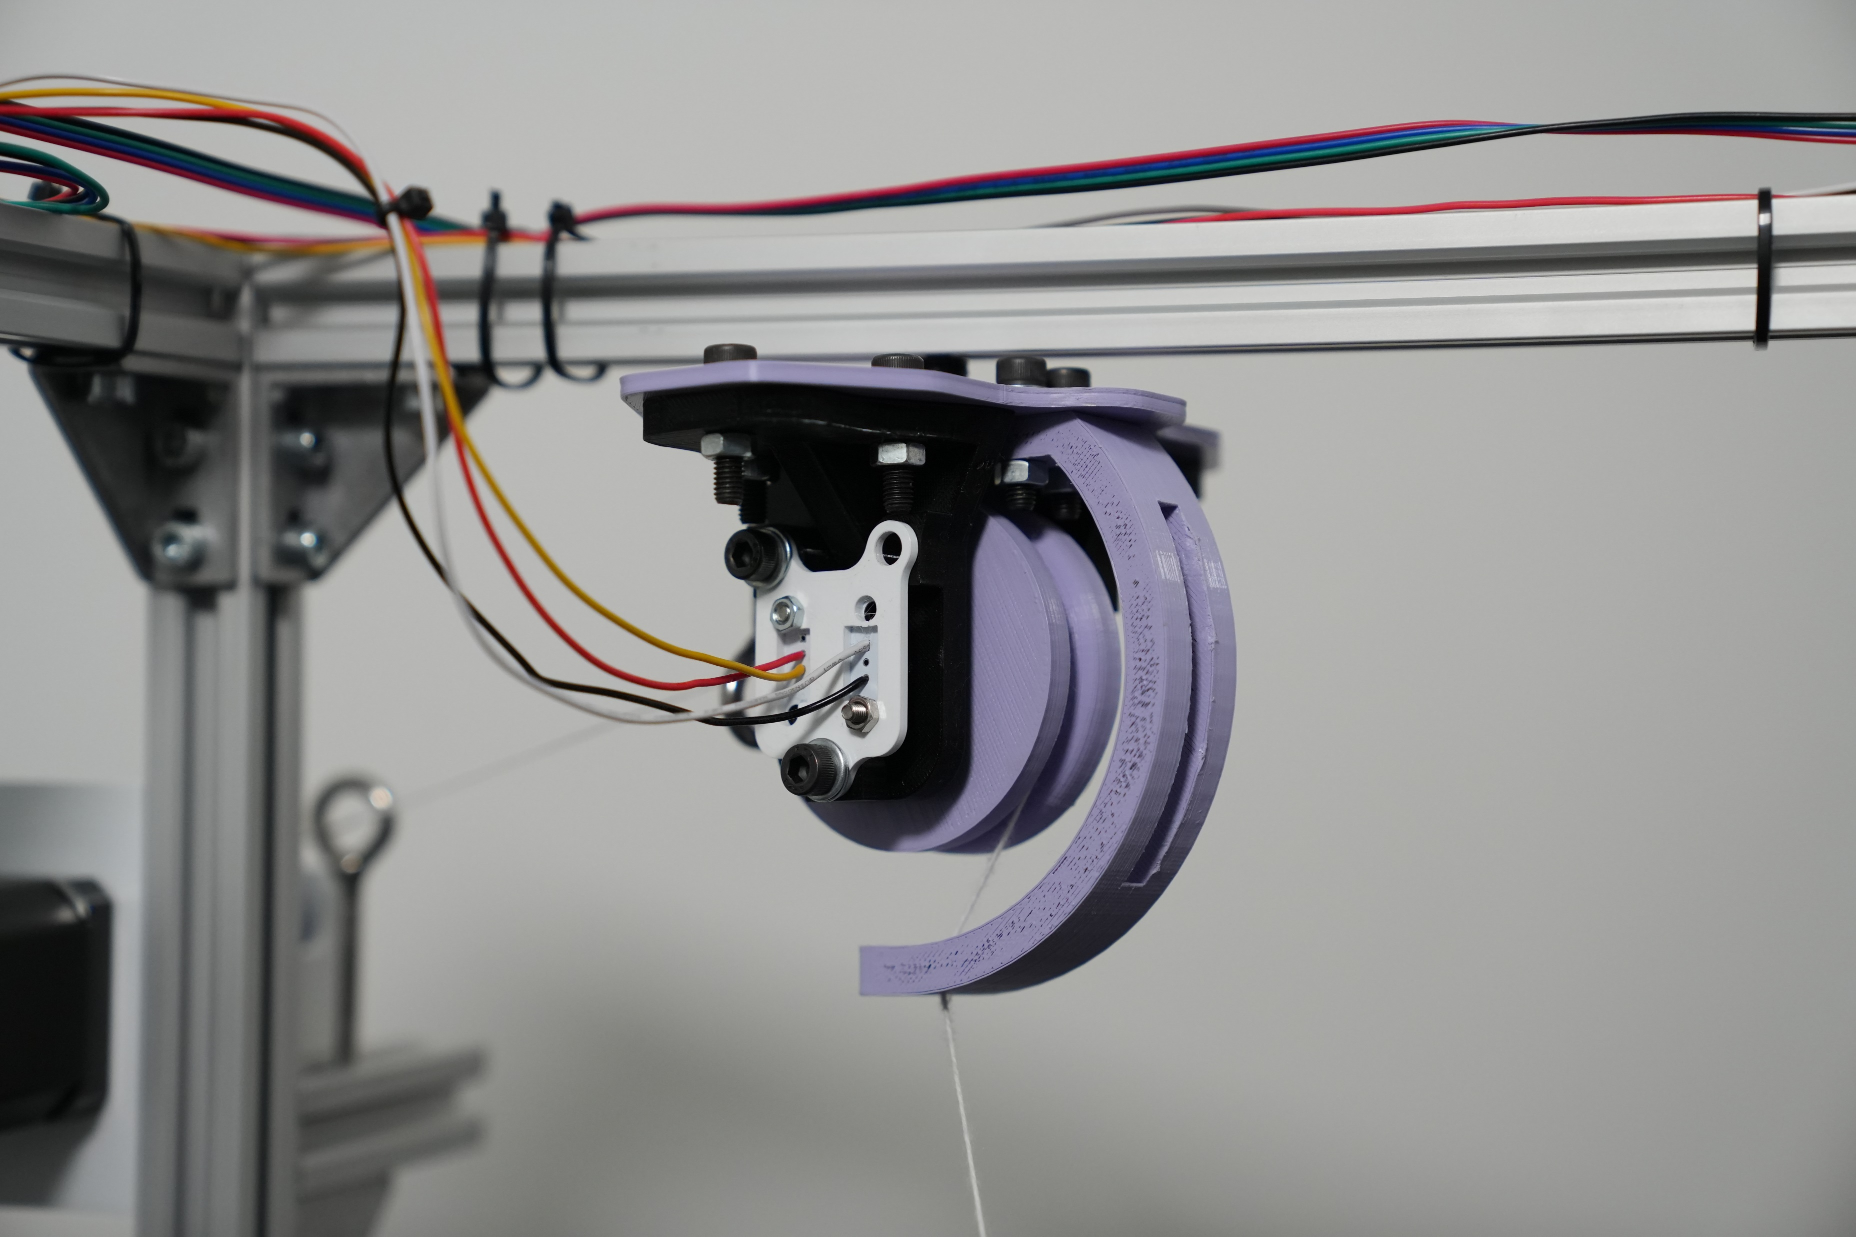

Slide 16
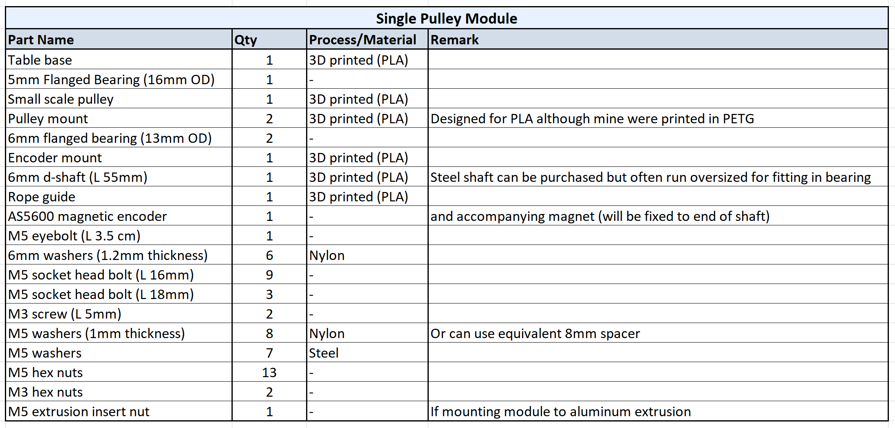
Pulley module BOM

Slide 17
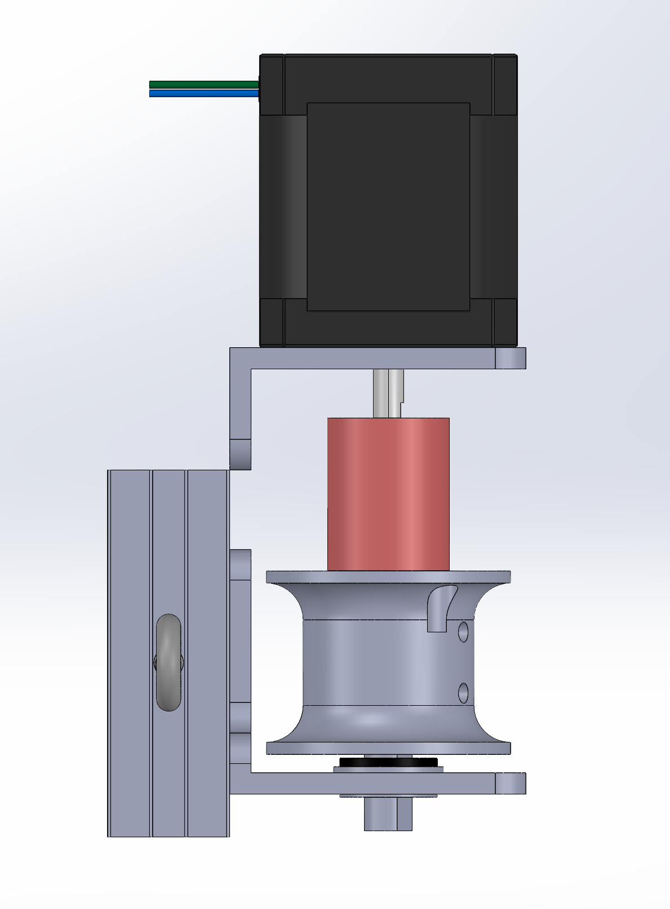
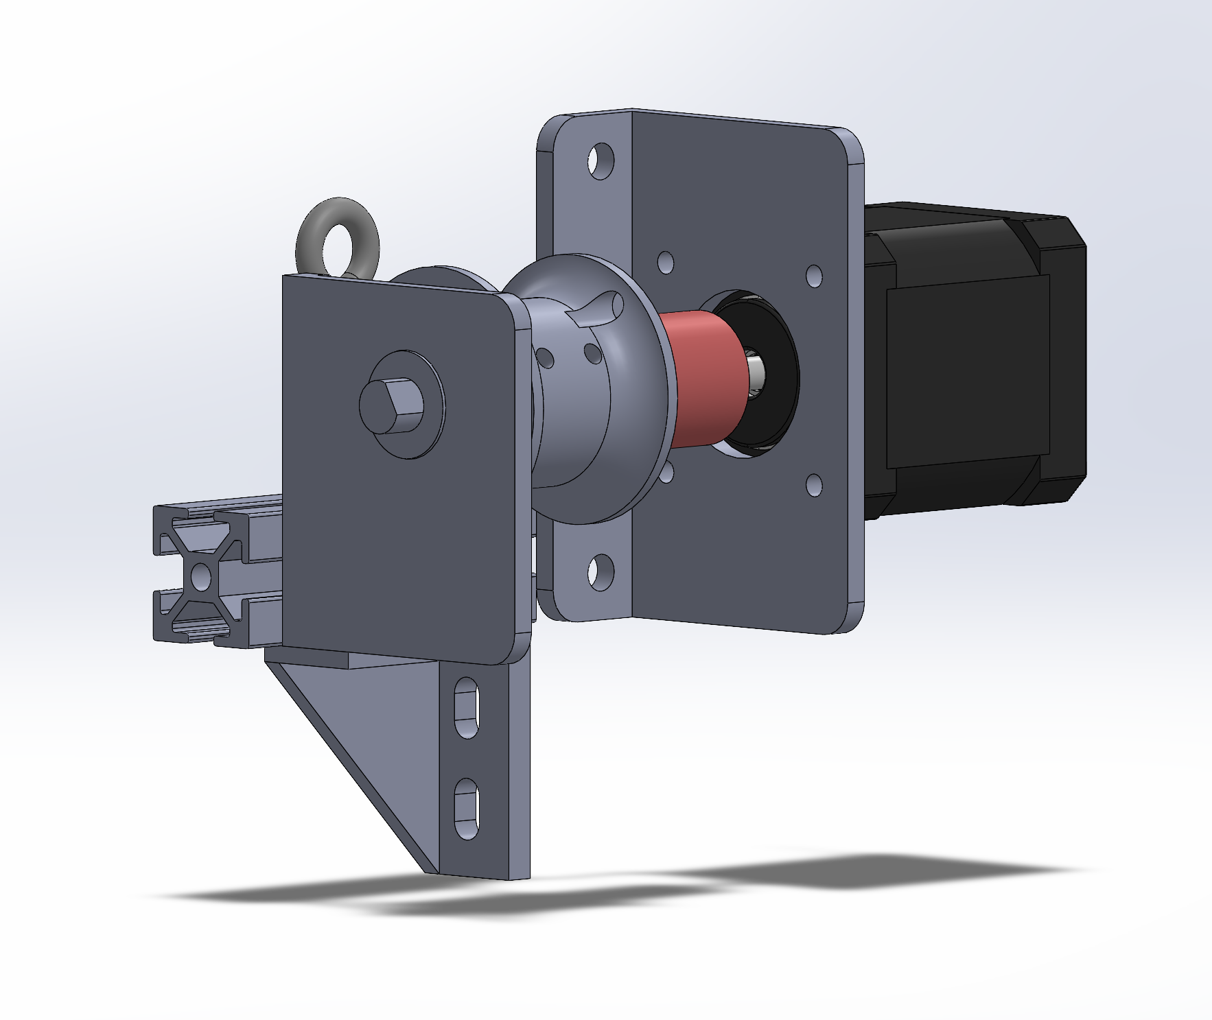
Winch module
NEMA 17 stepper motor
Compact, such that it can be placed anywhere
Eyebolt to prevent string from derailing off of winch spool
Most parts 3D printed
String secures to winch here (knot)
string

Slide 18
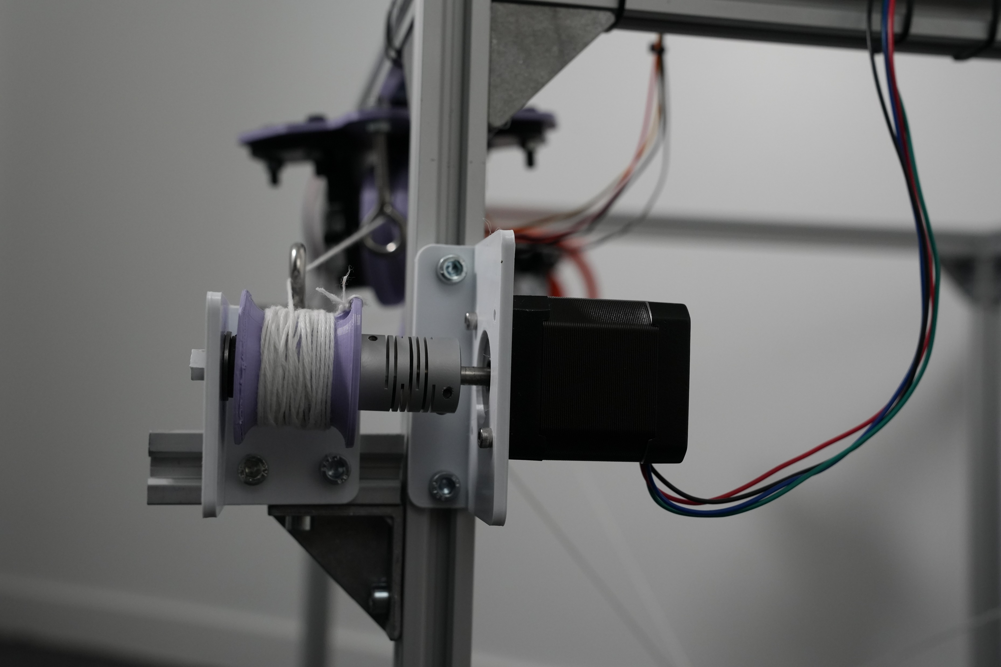
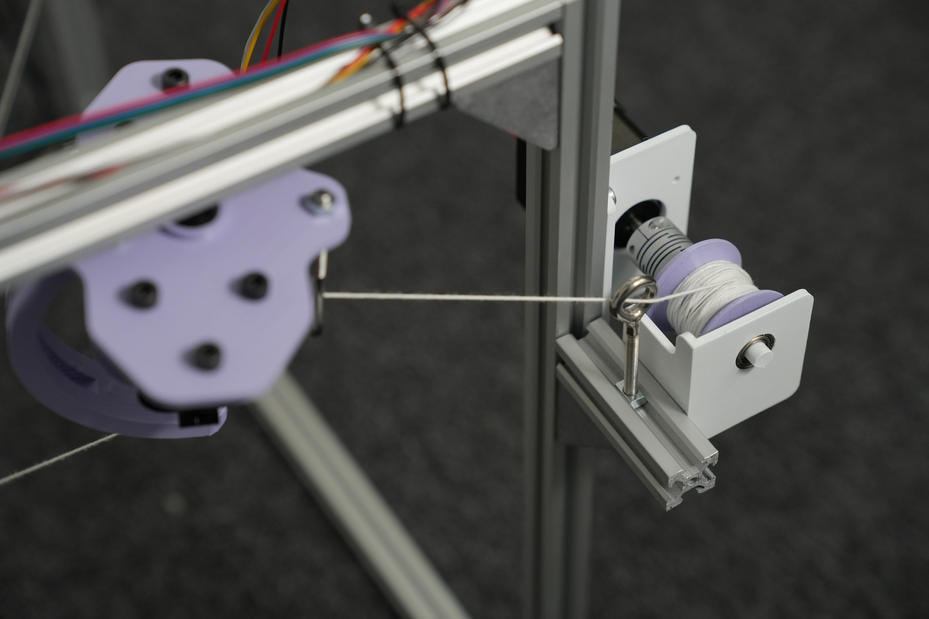

Slide 19
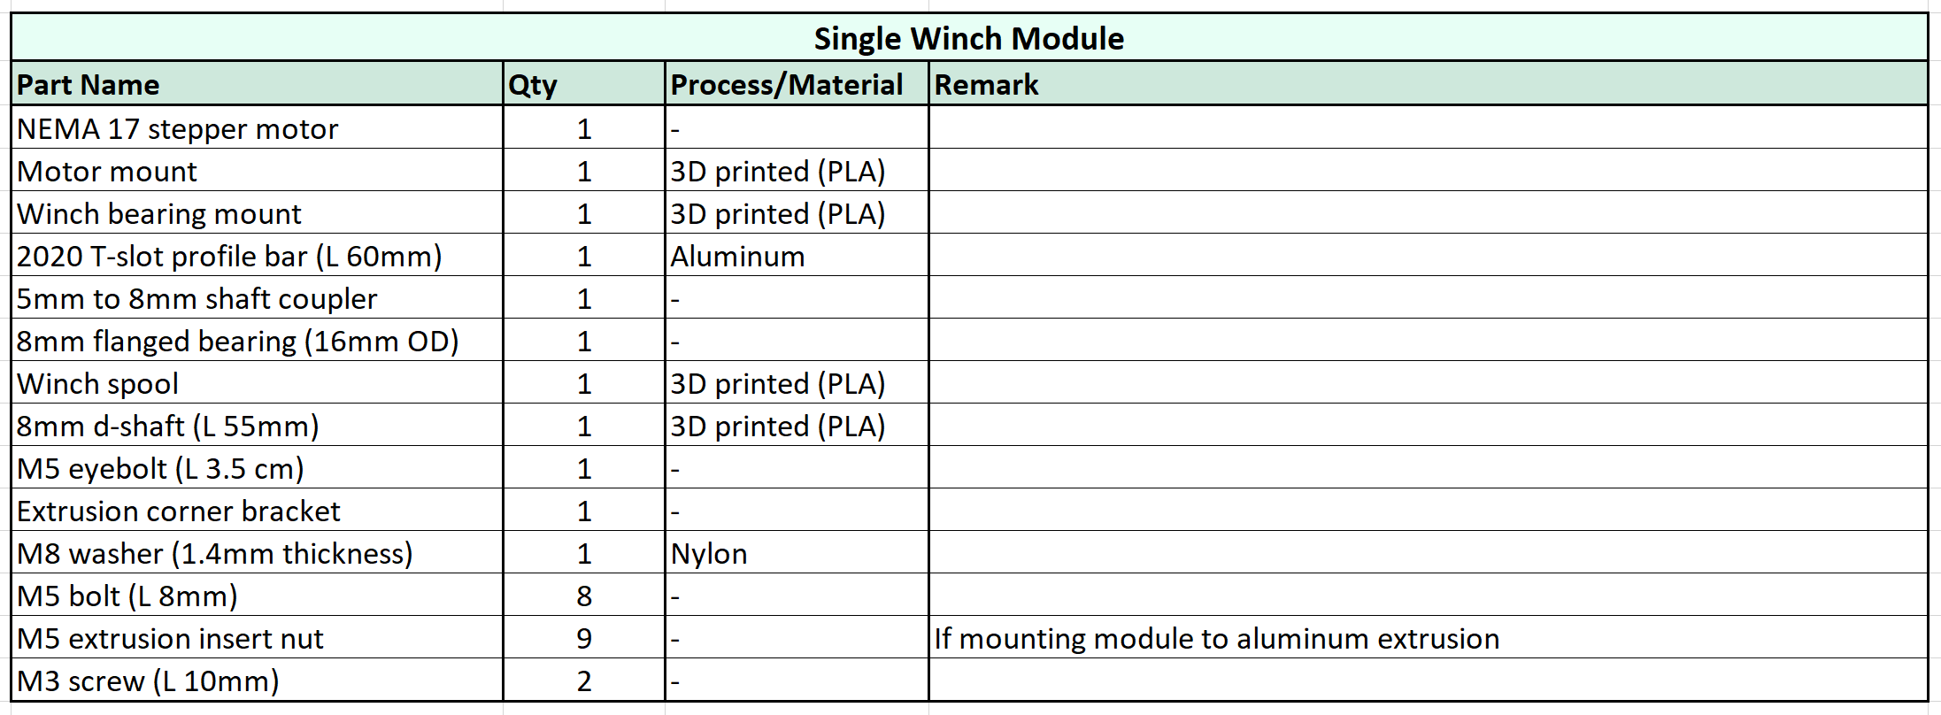
Winch module BOM

Slide 20
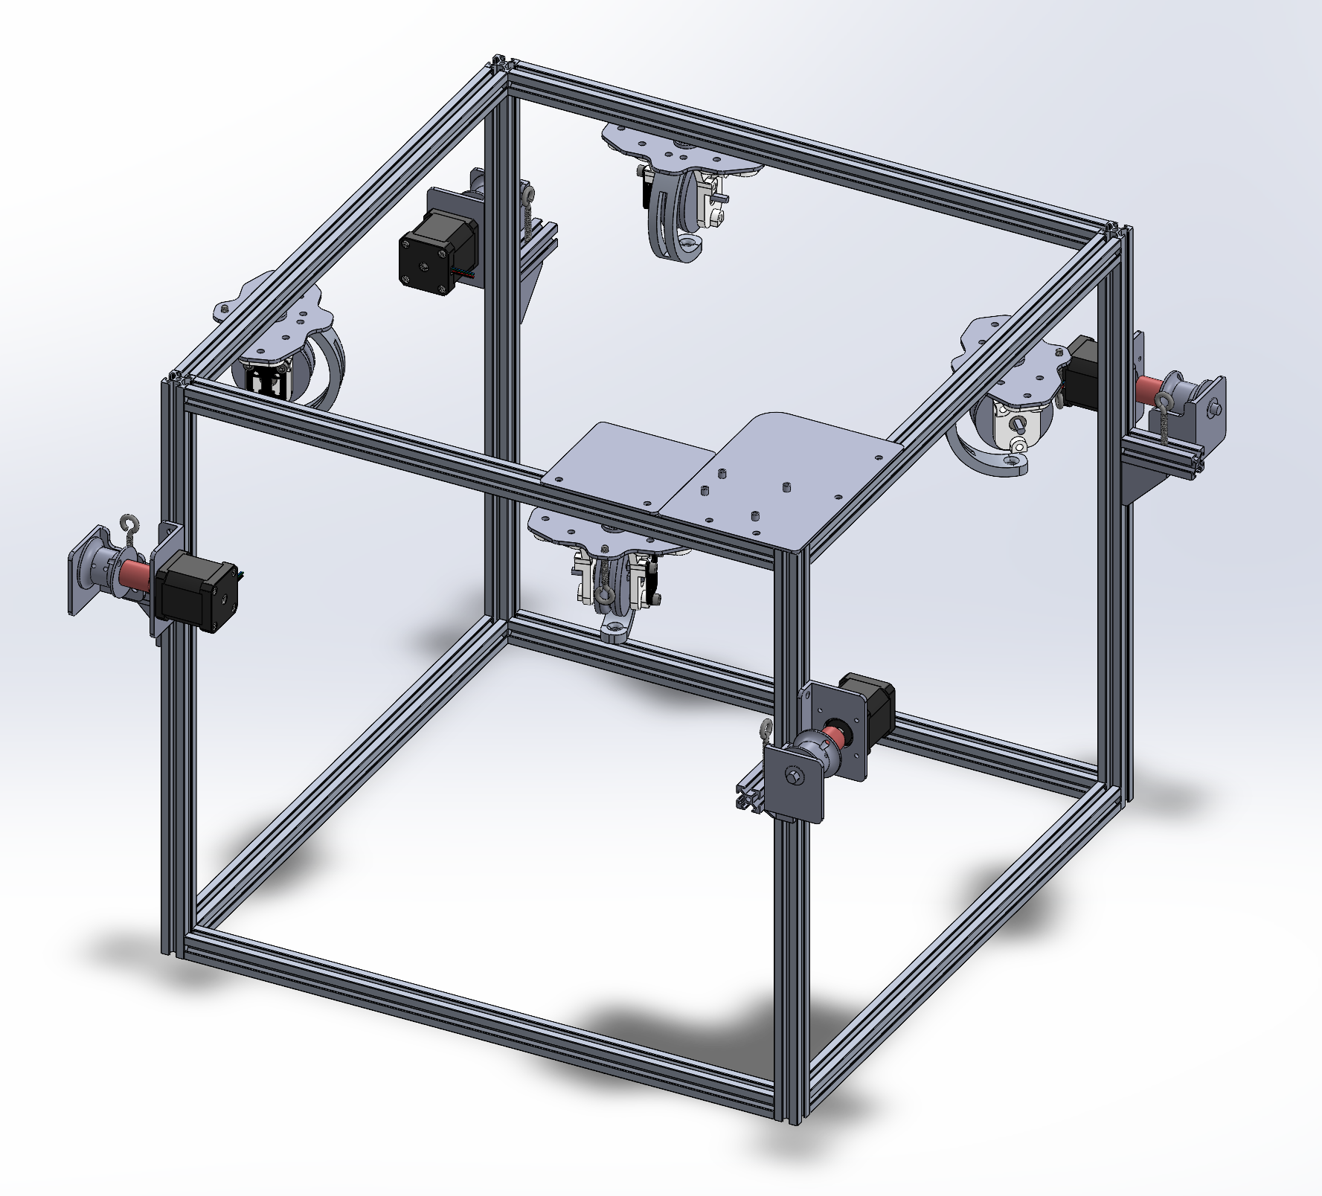
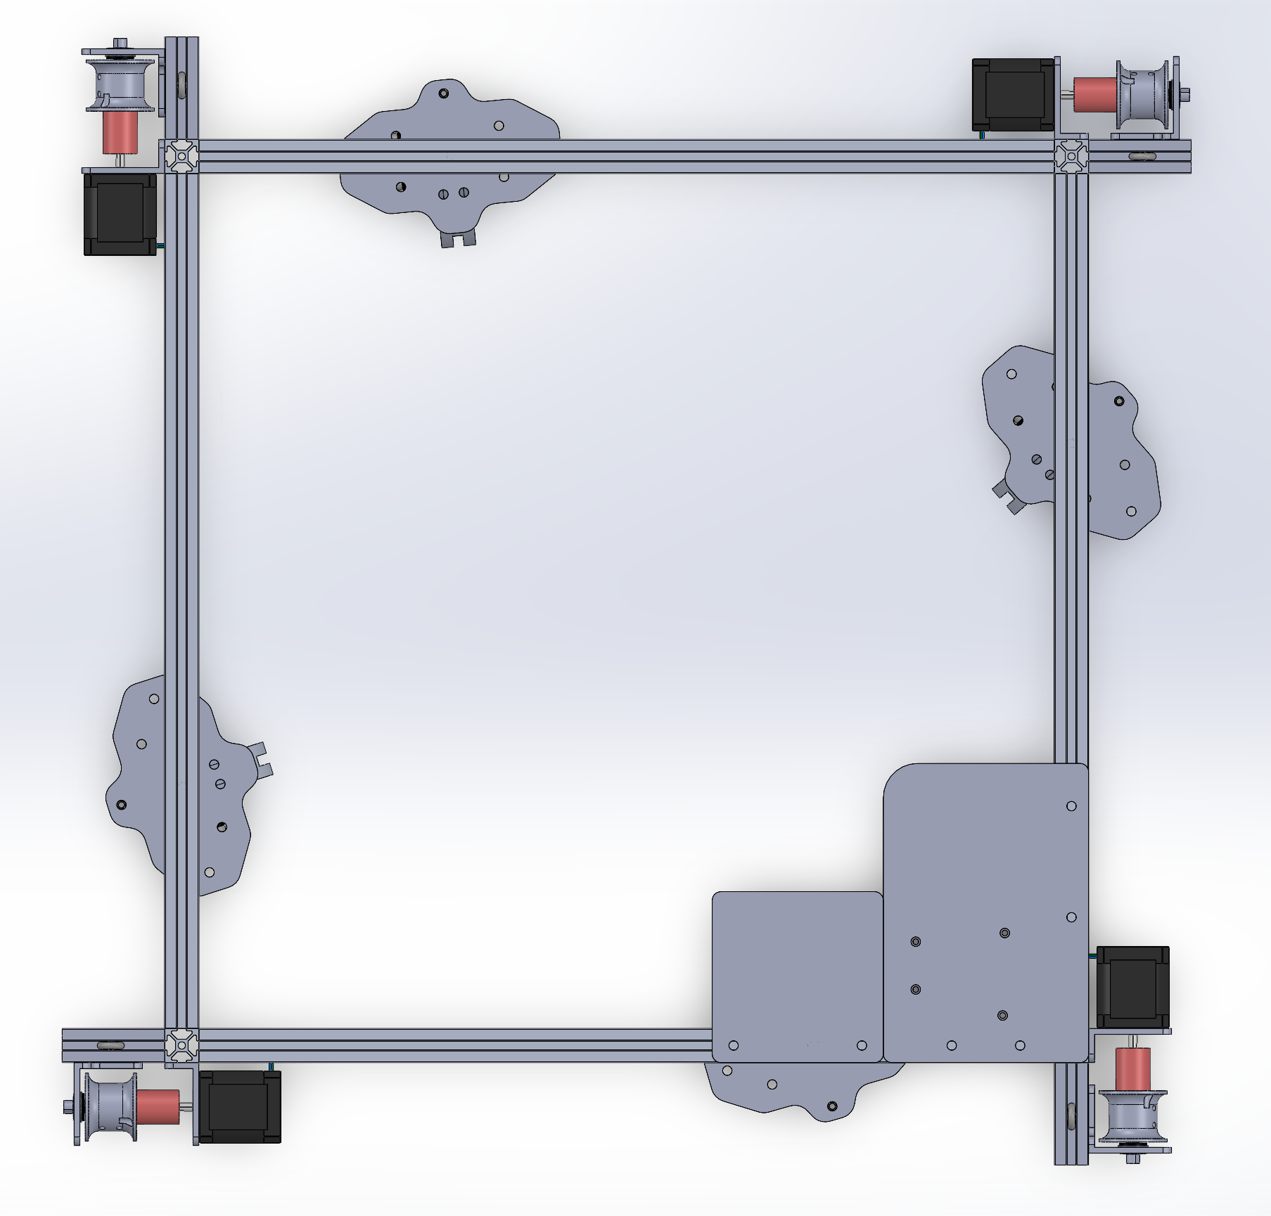
Structural schematic
C
D
400mm
between pulleys (and string exit points)
Electronics boards
Uses 2020 aluminum extrusion for easy assembly (corner brackets for frame connections not shown).
~70 cm x 70 cm footprint
Distance between pulleys can change but calculations for cable lengths in Python program will need to be adjusted
Pulleys are labeled for reference in code
A
B

Slide 21
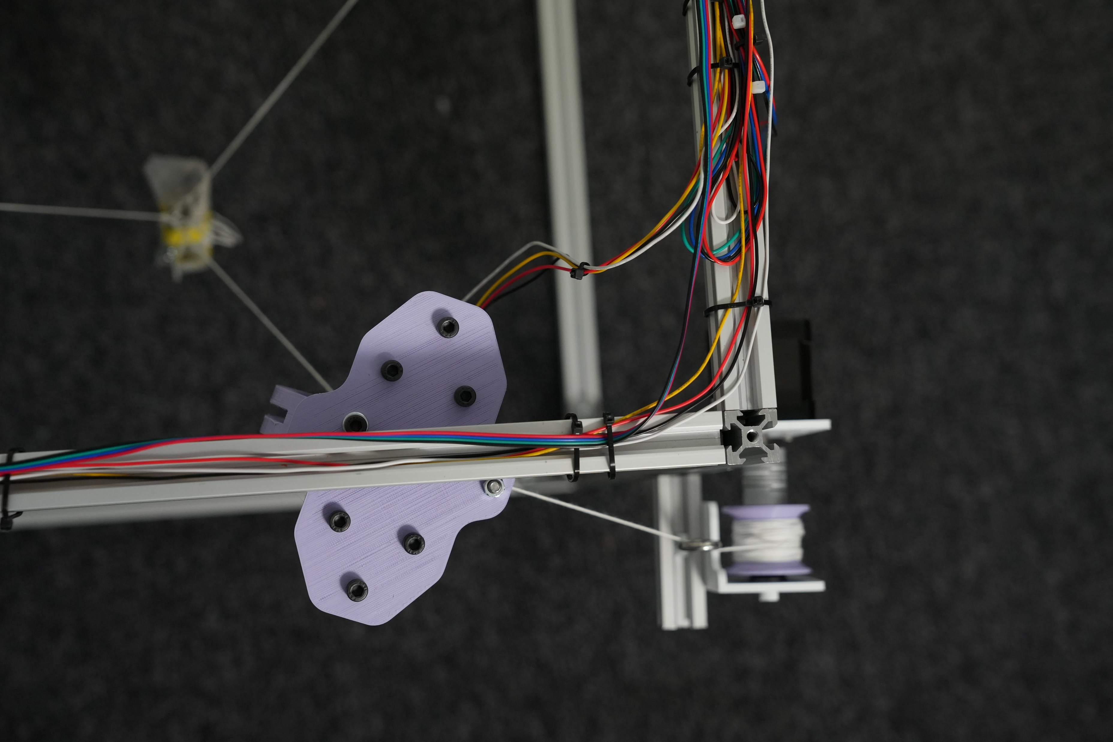
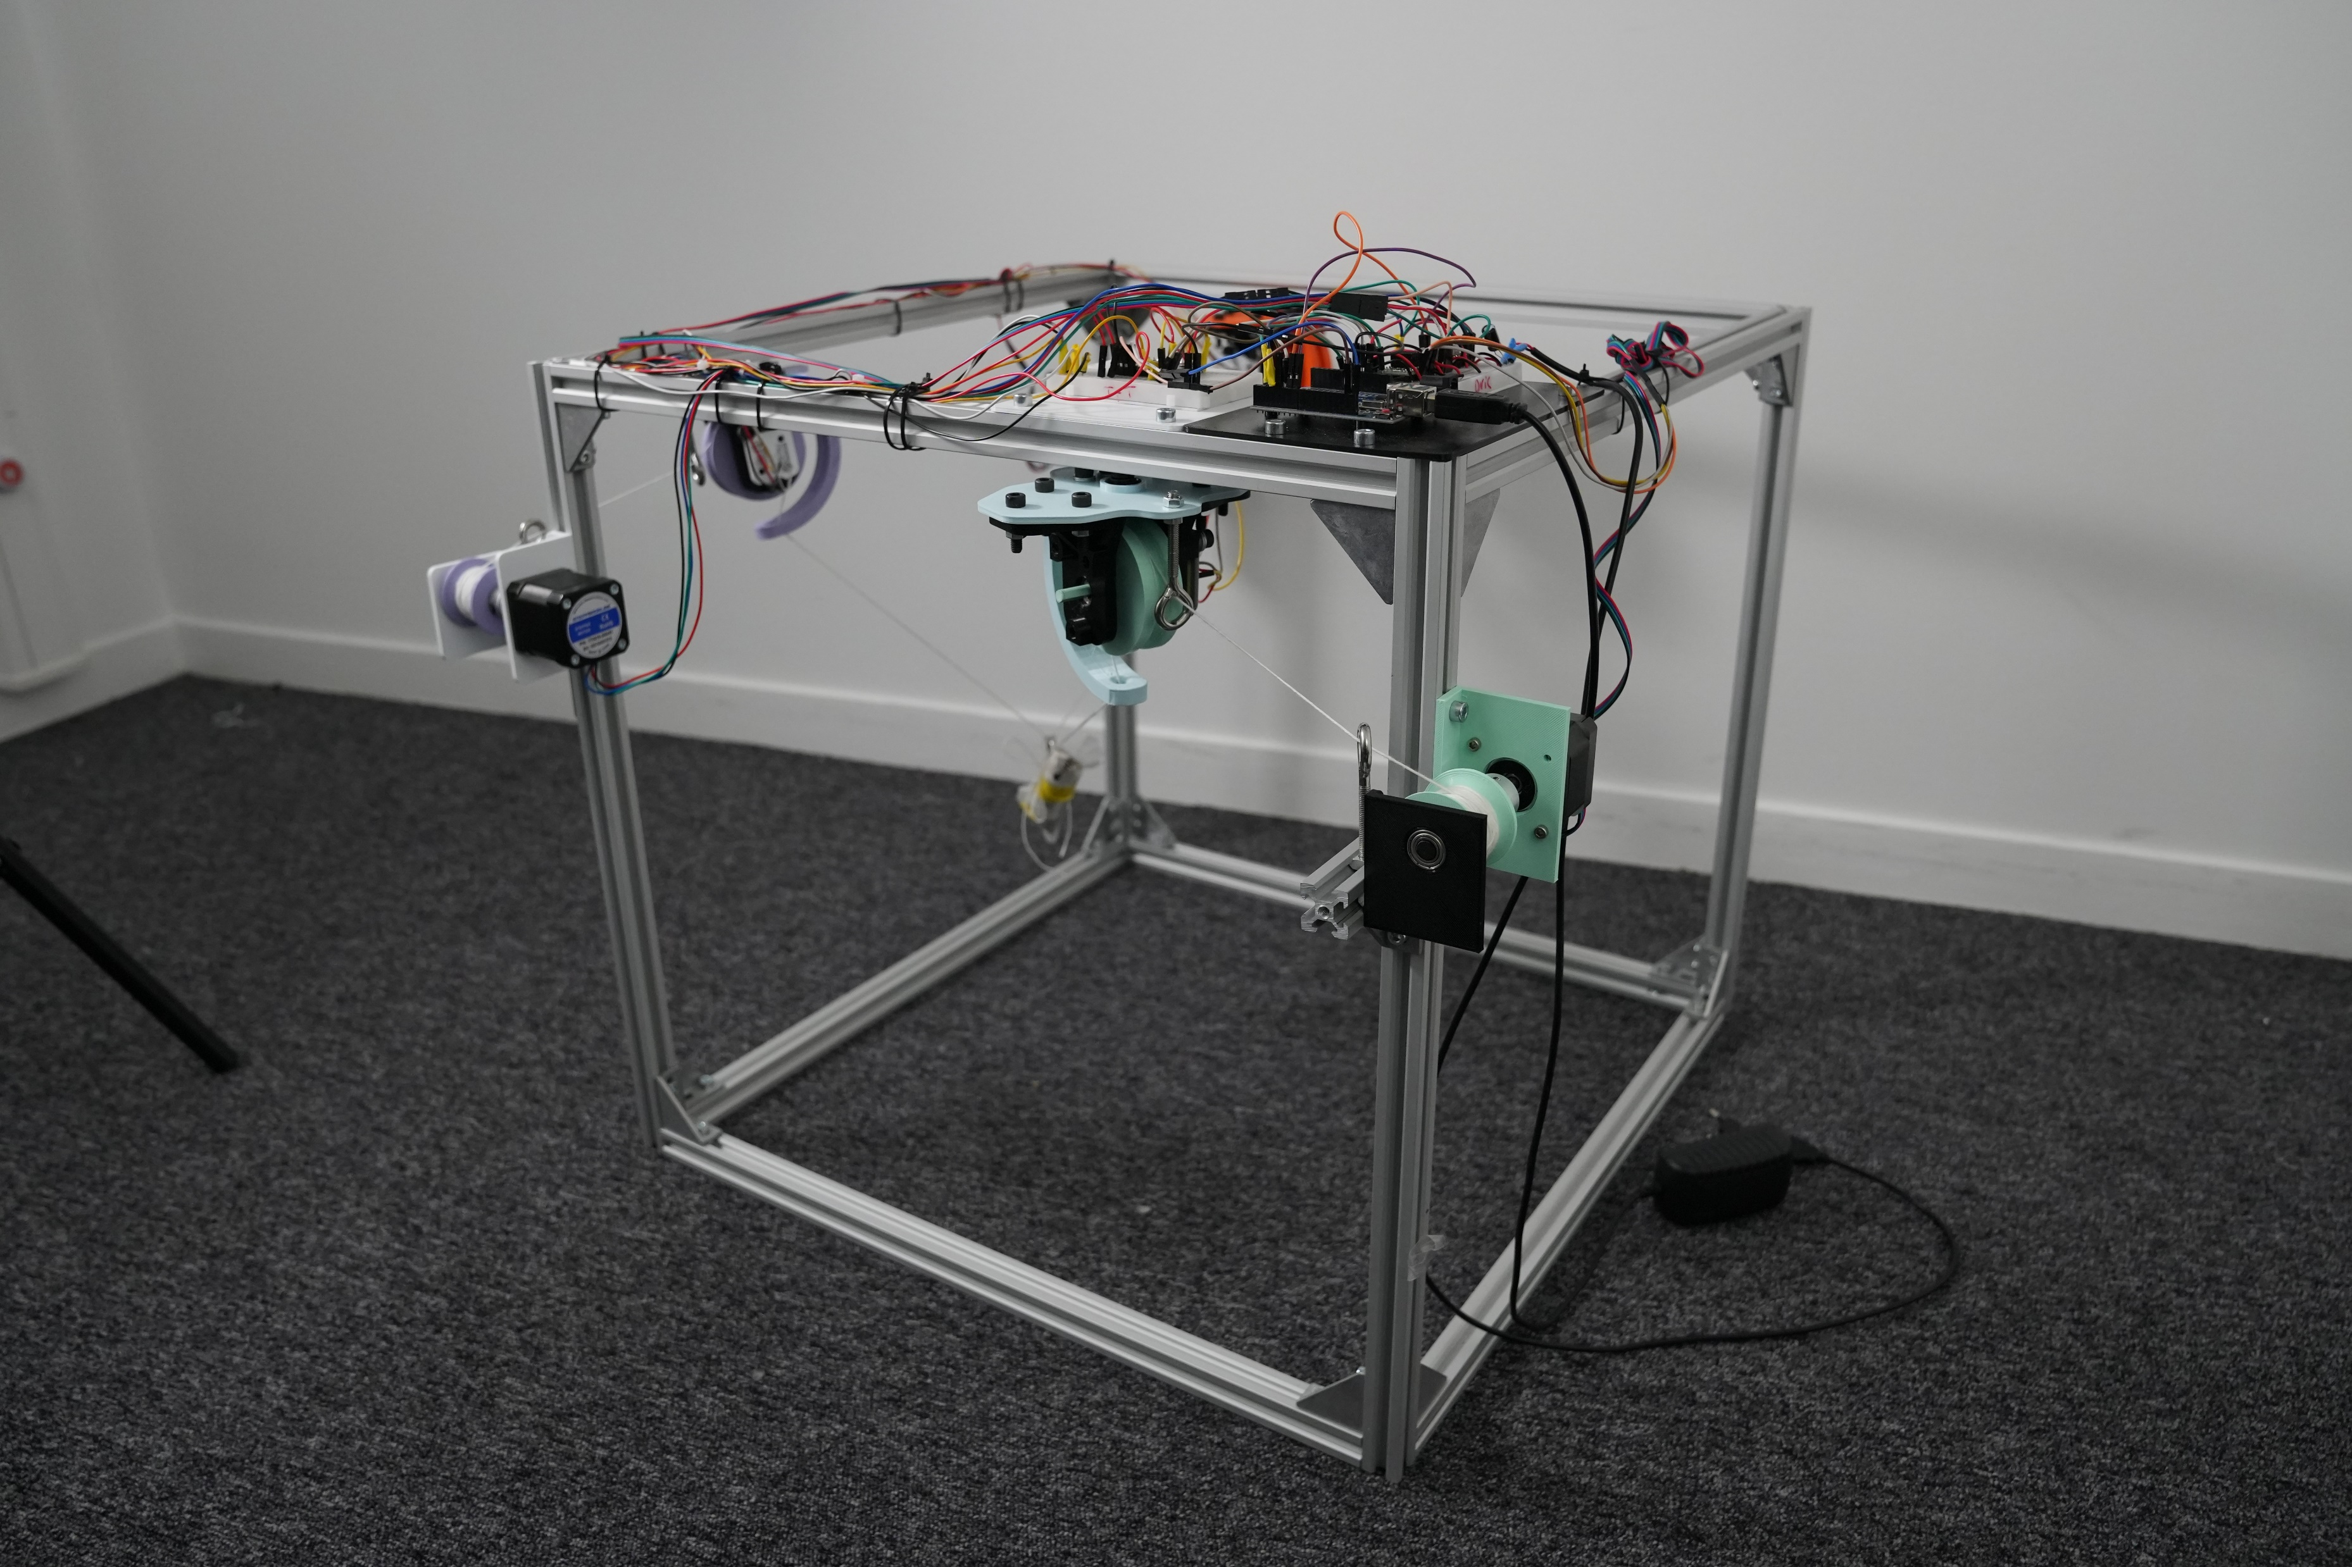
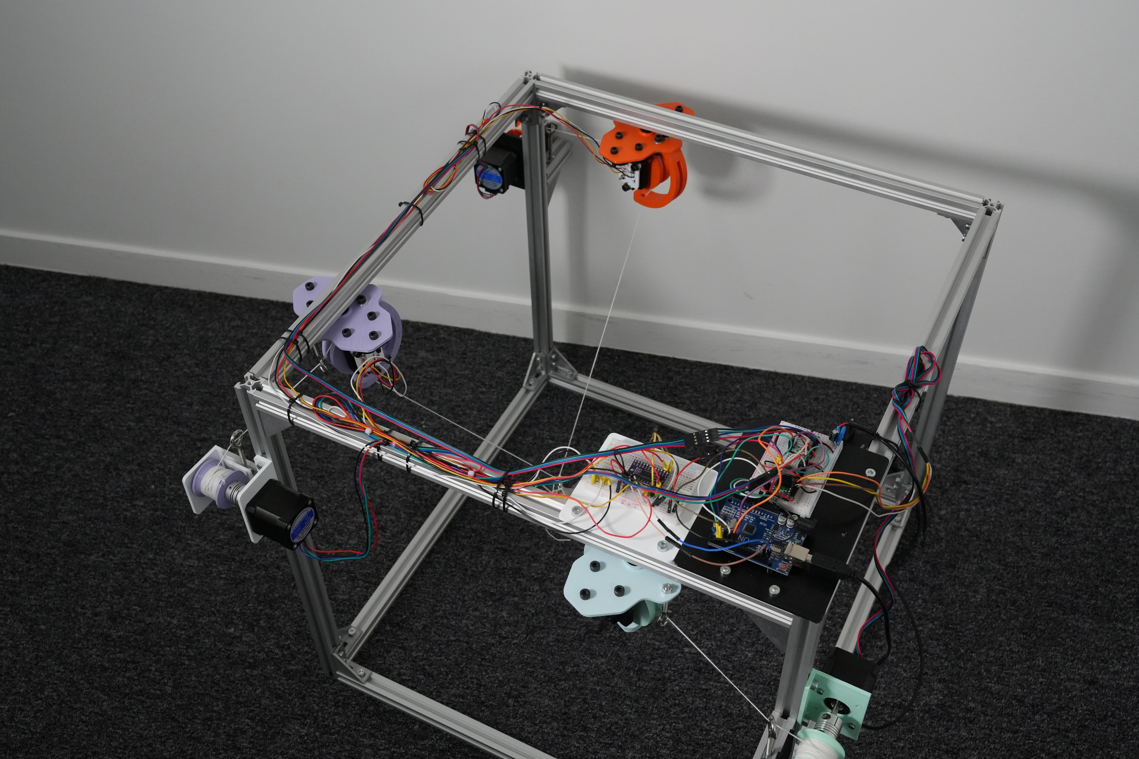
*4th module not yet added

Slide 22
Electronics/hardware

Slide 23
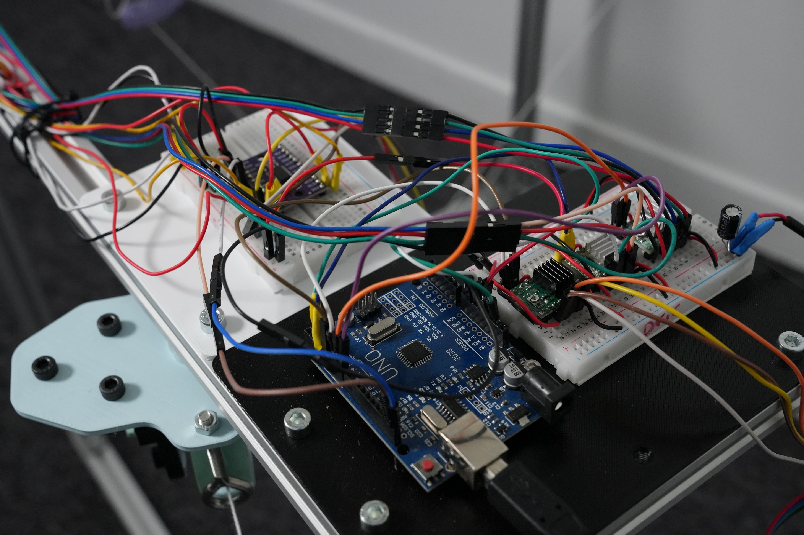
Components
Arduino Uno
A4988 stepper motor drivers (1 per motor)
AS5600 magnetic encoder (1 per pulley)
I2C multiplexer
100 µF capacitor
12V power supply

Slide 24
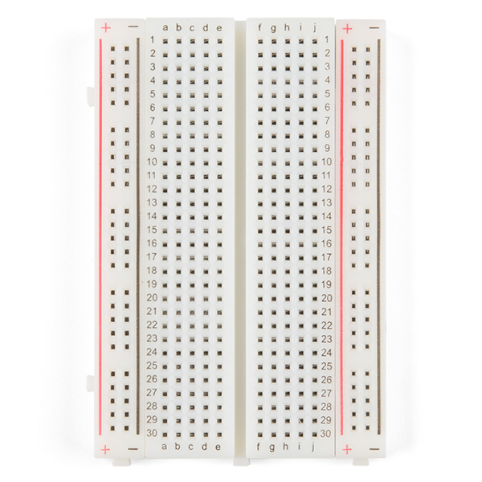
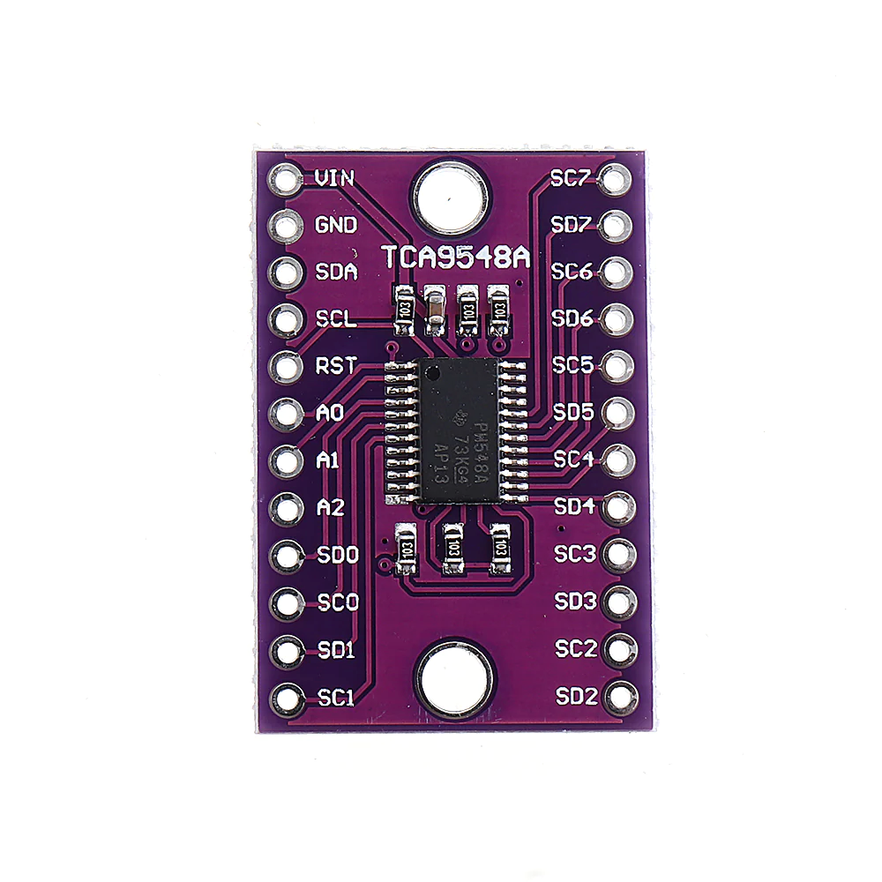
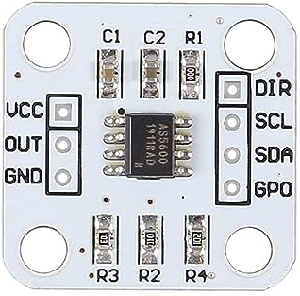
I2C and encoders schematic
5V
GND
Can add up to 8 encoders easily with 1 I2C multiplexer in this method
SDA
SCL

Slide 25
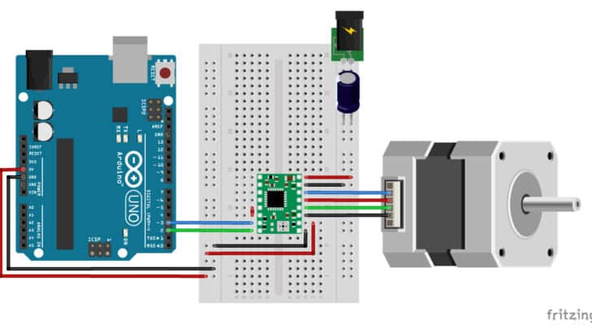
Motor driver schematic
Add motor drivers and motors with same connections
Do not plug/unplug motors when 12V power supply is connected and on!
https://www.makerguides.com/a4988-stepper-motor-driver-arduino-tutorial/

Slide 26
Software

Slide 27
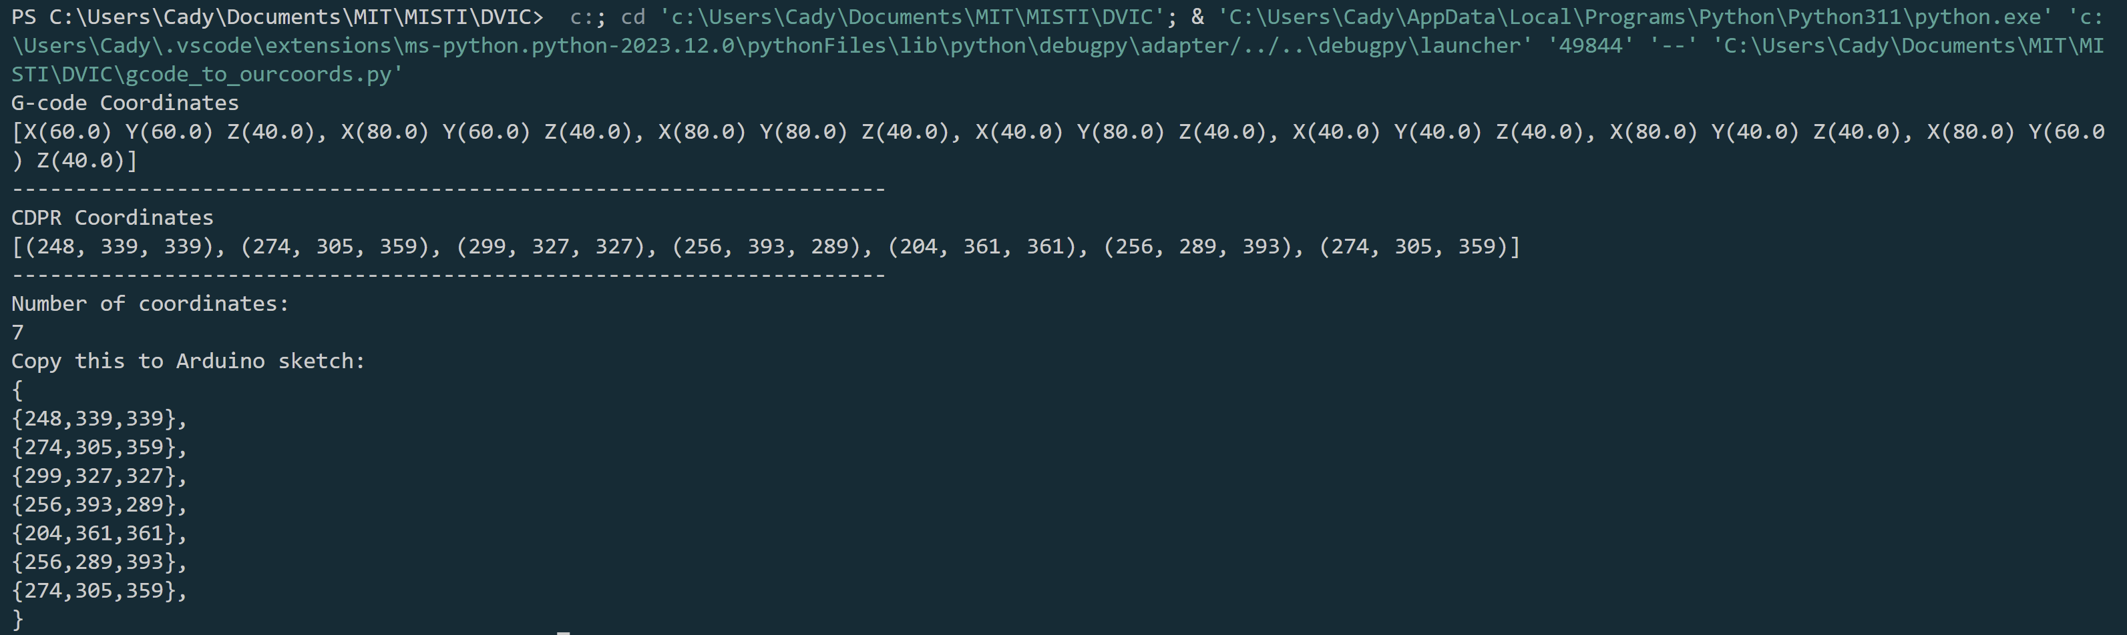
Converting G-code to cable length coordinates
Python program: gcode_to_ourcoords.py reads a G-code txt file and outputs a string of coordinates that can be copied into the Arduino sketch to control the pulley system.
It also outputs the number of coordinates, which will need to be set in the Arduino sketch.
Currently works best with not too long, cleaned up G-code (removing non-coordinate G-code lines/commands)
Calculation section will need to be adjusted for different pulley configurations (eg. different distance between pulleys)
Python program and example G-code can be found in GitHub repository: https://github.com/cxboronkay/Cable-Driven-System-for-3D-Printing

Slide 28
Controlling the machine
Arduino sketch for performing trajectory described by translated G-code coordinates: run_gcode_3pulley.ino
Copy coordinates from python program where indicated. Also adjust numcoords value and the initiation length for the coordinates list.
Manually rotate winches to position end effector at the starting position noted in the sketch (originally 200, 350, 350 mm).
Once uploaded to Arduino, begin Serial and turn on 12V power. There is an intentional 10 second delay before it will begin to move (can be shortened or removed if desired). It will then move to each coordinate in the list before stopping.
Next location, current coordinates, and speeds will all appear in the Serial print out.
Pulleys A, B, and C refer to the same pulleys noted in the structural schematic shown in the Mechanical Design section.
https://github.com/cxboronkay/Cable-Driven-System-for-3D-Printing

Slide 29
Future steps

Slide 30
Next
To get closer to the end goal of a large-scale CDPR 3D printer, next steps include:
Adding 4th pulley to gain another degree of freedom (be able to partially control angle of end effector).
Improve software and control over trajectories.
Scale up to be able to support the 3D printing nozzle.
Make design more modular (mountable to anything, sturdier, etc.)

Slide 31
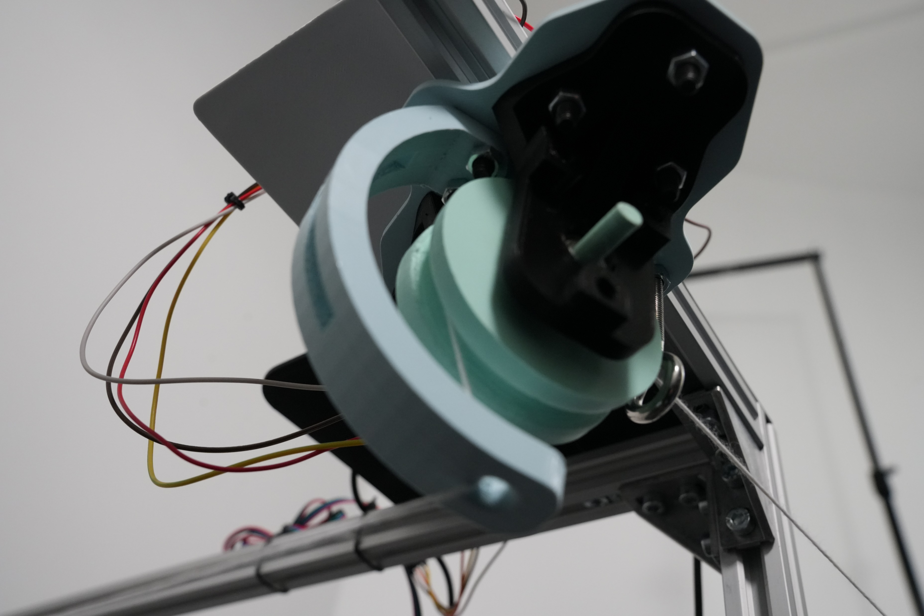
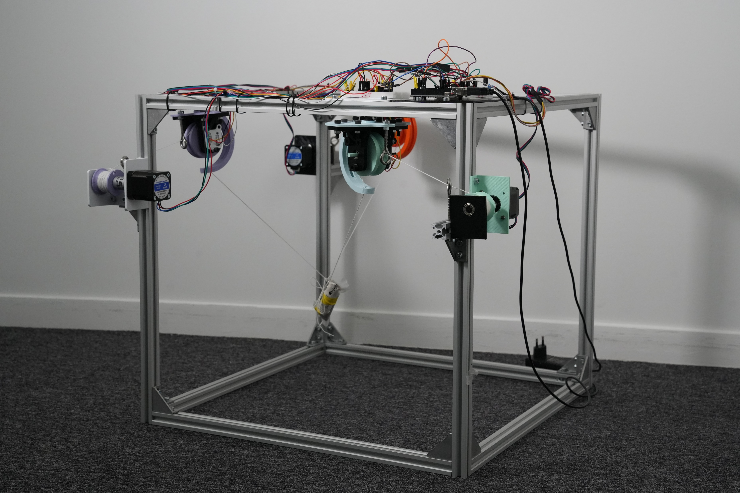
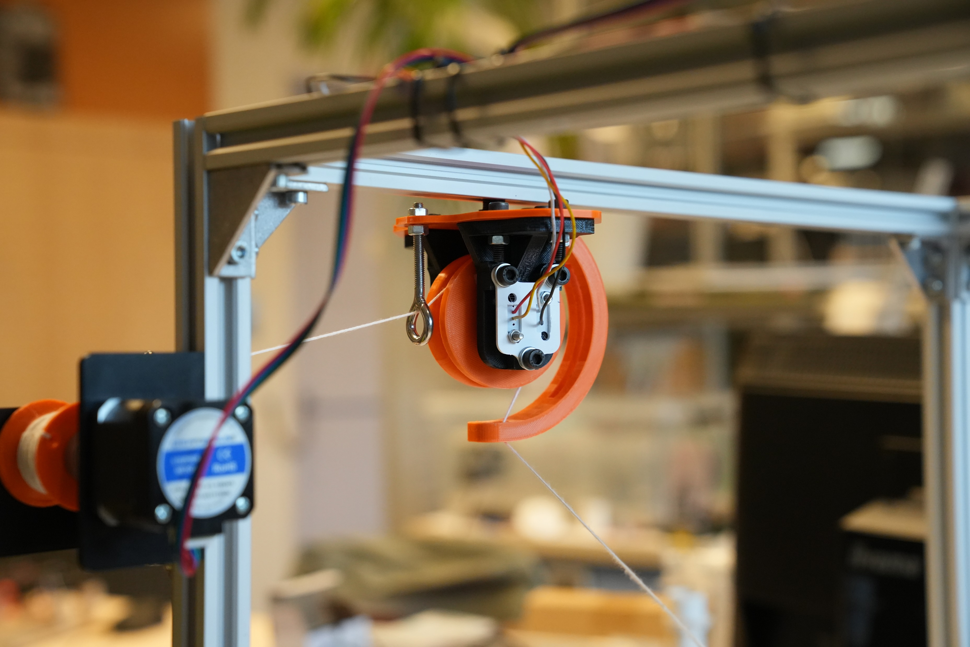
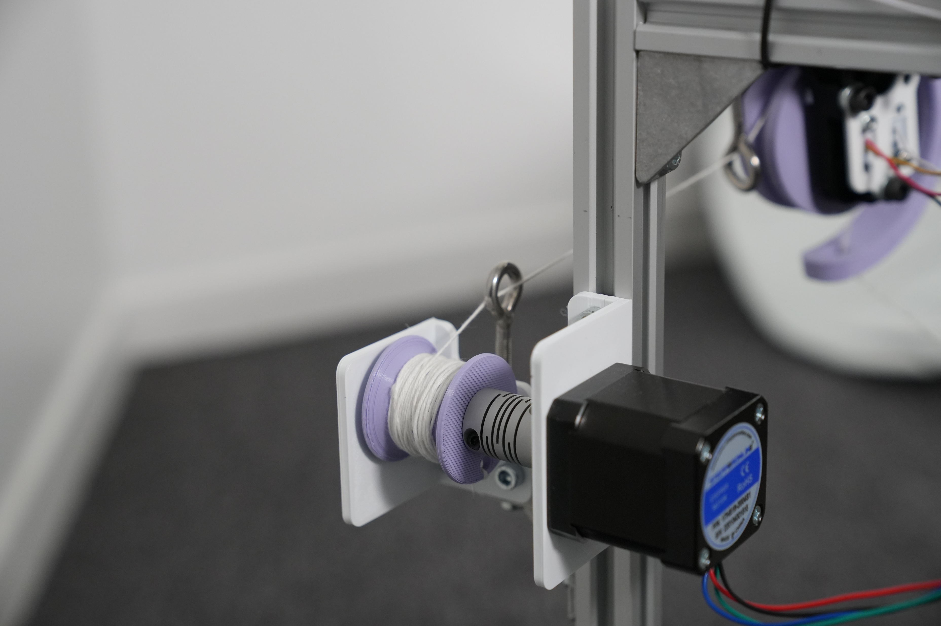
Thank you!!
Contact:
Cadence Boronkay
boronkay@mit.edu
cwxboronkay@gmail.com
+1(408)797-5285

